Slide 1
S-100 Validation Tests sub group
15th VTC Meeting
1st September 2026

Slide 2
Meeting protocol
Meeting participants are kindly requested to note the following meeting protocols;
Please keep your camera and microphone turned “off” if you are not talking or presenting
If you want to make an intervention, please turn your camera and microphone on and, raise your hand to indicate that you wish to speak
Don’t forget to turn your microphone “on” before speaking, and “off” when finished
Please use the “Chat” function to communicate an text information to the meeting
If you have any problems connecting using Firefox or other browser – please try using Chrome.

Slide 3
AGENDA
Update from S-100 TSM & HSSC 18
Work plan for Edition 2.0.0
Preparation for S-100 WG11
Edition 2.0.0 Progress and issues for resolution
Next meeting

Slide 4
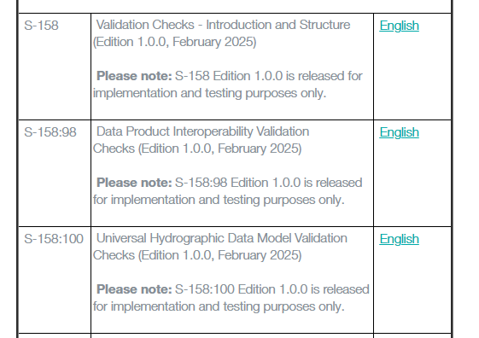
S100 validation sub group standards

Slide 5
Update from S-100 Test Strategy Meeting 12 (TSM)
Edition 2.0.0 for HSSC 2027 or HSSC 2028?
Agreed on HSSC 2027
Concern regarding having operational data on the market but not working on operational validation checks
Alignment with S-158:101 – aiming for Edition 2.0.0 for HSSC 2027
Cons:
Less time to prepare
Limited feedback
Once publish Edition 2.0.0 fall into impact assessment routine
Concerns have been raised at HSSC regarding the maturity of the validation checks

Slide 6
Check Classification
Consensus at TSM was that while understanding the merits behind the suggestion that now was not the correct time to do it.
Deadline to release Edition 2.0.0
Amount of work that would be required from each of the PS to bring their checks up to date
Potentially revisit when move the checks into the Registry and the valiation checks are more mature
Checks are currently written with a navigational use in mind
Agreed that individual S-158:xxx can upgrade an S-158:100 classification but cannot downgrade it
Will work on current experience with S-58 validation impacts and work with PTs where there is a disagreement
Criticals should be allocated for datasets that will make the data unusable or unsafe
Can review check clasification severity at later stage similar to S-58 Edition 9 review.
S-100 level vs PSes level "Fail" check category consideration · Issue #71 · iho-ohi/S-100-Validation-Checks

Slide 7
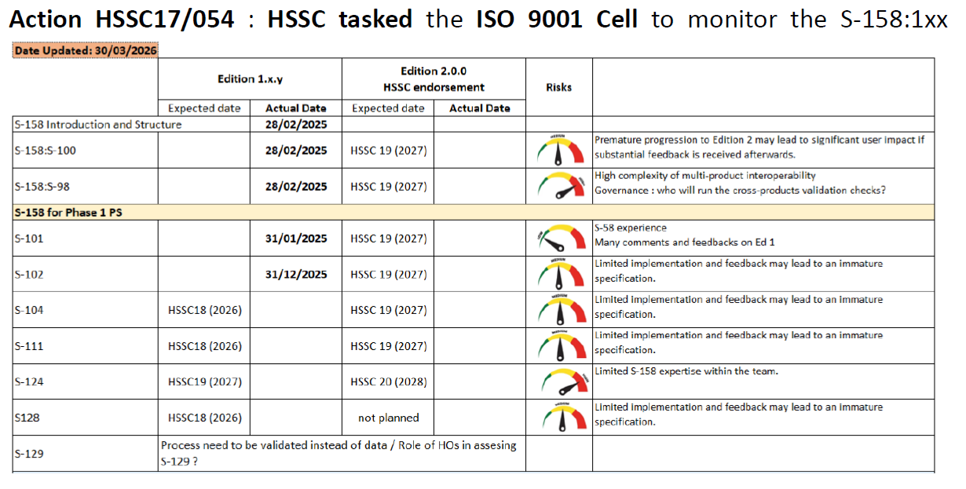
Update from HSSC 18
Concerns have been raised at HSSC ISO Cell regarding the maturity of the validation checks, across all S-158:xxx, except S-158:101

Slide 8
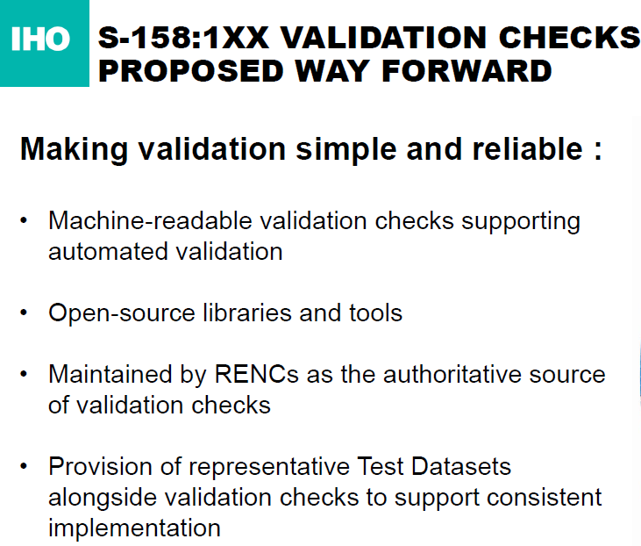
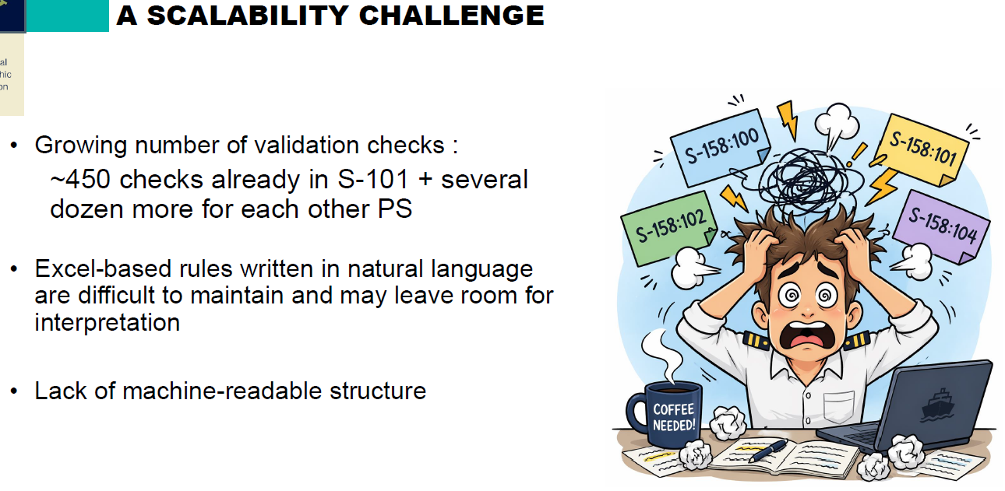
HSSC18/55: HSSC approved the proposed direction for the future of S-158:1xx and consider the potential role of RENCs in supporting the development and maintenance of authoritative tools and libraries for validation checks.
Proposal is to split cost 50/50 between RENCs capacity funds
Will speak to Nathalie in New Zealand

Slide 9
Work plan for Edition 2.0.0
 | Edition 2.0.0 | Status
1.1 | Kick off using funds for edition 2.0.0 & project outline | Complete
1.2 | Initiate work | Complete
1.3 | Update for S-100 5.2.1 | In progress
1.3 | Review GitHub issues for inclusion | In progress
1.4 | Review S-98 Data Constraints Annex for Edition 2.0.0 | In progress
1.5 | Review S-58 for potential changes, primarily classifications | In progress
1.6 | Coordinate with S-158:1xx regarding versioning concerns | To do – will send email/discuss at S-100WG
1.7 | Circulation in sub group | Draft version ready for review – will circulate
1.8 | Approval to S-100 WG – draft version | To do
1.9 | Potential approval from S-100 WG via circular letter | To do Final drafts due 30/12
1.10 | User impact study | To do
1.11 | HSSC endorsement | To do

Slide 10
Co-ordination with S-158:1xx leads
Originally planned to arrange a VTC with all the S-158:1xx leads
Primarily to discuss versioning issues
Has become too difficult to arrange and with time zone differences
Will send an email asking for feedback & will speak to S-158:1xx leads present in Wellington
Potentially arrange individual VTCs if required

Slide 11
Preparation for S-100 WG 11 (22-25th September)
Presentation based on todays slides and with status
Draft Edition 2.0.0 versions of:
S-158
S-100-Validation-Checks/Documents/S-158/2.0.0/WD-158 Validation_Checks_2_0_0_20260831.docx at main · iho-ohi/S-100-Validation-Checks
S-158:100
S-100-Validation-Checks/Documents/S-158-100/2.0.0 at main · iho-ohi/S-100-Validation-Checks
S-158:98
S-100-Validation-Checks/Documents/S-158-98/2.0.0 at main · iho-ohi/S-100-Validation-Checks
Any comments submit via GitHub issue
Following revised TR2/2007 naming convention

Slide 12
Alignment with S-100 edition 5.2.1 - 1
Location | Summary | Disposition
7-4.2.11.1 | Removed requirement that all geometric primitive must be part of at least one GM_Aggregate | No effect on VCs, issue was dealt with while preparing 158:100 1.0.0
10a-7-2.1.2 | COCC field update – NCOR = number of tuples following if COUI is Insert or Modify | Covered by 100_0120
10a-7.2.4.2.3 | SECC field update – NSEG = number of segments in update record if SEUI is Insert or Modify | 100_0138, desc OK but correct message: SECC-SEUI -> SECC-NSEG
10a-7.2.5.2.2 | COCC field update – NCCO = number of curve record pointers if CCUI is Insert or Modify | 100_0142, desc OK but correct message: COCC-CCUI -> COCC-NCCO
Three Part 10a items above | Typical S-100 language: Number of Curve record pointers to be inserted, deleted or modified If CCUI is Insert(1) or Modify(3) this is the number of Curve record pointers in the CUCO field(s) of the update record Typical VC: For each CCOC field where CCUI is Equal to 1 (Insert) or 3 (Modify) AND NCCO is Not equal to the number of curve components in the update record. | S-100 language: Nothing about value of NCCO for deletion (implying actual #). VC: Nothing about deletion. S-100 10c Change Summary is “Amended subfield comments for COCC-NCOR, SECC-NSEG and CCOC-NCCO to recognise that for a Delete instruction there should be no items present.” New checks and/or S-100 clarification needed w.r.t. deletion.

Slide 13
Alignment with S-100 edition 5.2.1 - 2
Location | Summary | Disposition
10b-7 | Extension for GML datasets must be .GML | New check NB: Parts 10a & 10c don’t have equivalent requirements; instead, the product specifications do.
10b-8.4 | Encoding associations by reference is no longer allowed. | No action for VC, PS requirement.
10b-8.4 | Deleted “Bidirectional encoding allowed by means of encoding reverse property name in appInfo element.” | No action for VC. Concerns GML schema, i.e. PS package.
10b-8.4.1 | Intermediate class name for association class encoding | No action for VC, concerns GML schema, i.e., PS package.
10b-9 | Ordering of (inherited) elements in GML schema | No action for VC, concerns GML schema, i.e., PS package.
10b-9, 10b-11.4 | Use of xlink:title | Already in S-158:100, 100_0175, 100_0176
10b-9.1 | Position data must use <pos> or <posList> | Enforced by S-100 GML profile, which has never allowed the <coordinates> element. New check to permit only <posList> (not <pos>) for curves and surface boundaries.
10b-11.1.1 | Guidance for use of schemaLocation and Schematron rule, recommends Schematron validation check in PS | New S-158:1xx check(s), W since S-100 “recommends” it for Product Specifications.

Slide 14
Alignment with S-100 edition 5.2.1 - 3
Location | Summary | Disposition
10b-11.4 | Information association on spatial type must have arcrole | Amend 100_0177 to include reqd. format for value of arcrole (or add new check).
10b-11.6.1 | updateNumber in dataset identification header must be ≥ 0 | No action for VCs, GML profile enforces it
10b-11.7 | Coordinate order must be as per the CRS | New VC. Not clear a software check can be fully specified for this requirement, some cases may need visual inspection or heuristics.
10b-14 | Schema availability | Procedural requirement, no action for VCs
10c-9-5 | Optional attributes not used in dataset need not be encoded in Group_F. | Amend 100_0210 to require optional attributes iff they are present in values records.
10c-9.6.2 | Feature attribute table element must have component named featureAttributeTableKey | Amend 100_0215 and 100_0216 to change “id” to “featureAttributeTableKey”
Table 10c-12 | Unit of grid origin/spacing must conform to CRS used for the dataset | New check? 100_0222/0223 are relevant but not equivalent to the requirement. May need visual inspection, production code test/verification, or heuristics.
Table 10c-19 | Multiplicity of timestamp is now 0..1 | No change? Formulation of 100_0242 still works.

Slide 15
Alignment with S-100 edition 5.2.1- 4
Location | Summary | Disposition
10c-9-11.1 | Name and data type of feature identification value (in values record) must be identical to the identification value from the feature attribute table (if DCF 9 feature is also present). Presumably saying that the name must be featureAttributeTableKey in both places. | New check(s) comparing name and data type in both places. Does “type” include precision (1/2/4 bytes)? Perhaps this should be a PS check.
11-13 | Transfer size must use standardized unit | No VC action, PS requirement.
17-4.3 | Corrections to filePath format | Covered by 100_0282
17-4.4.1 | For file-based cancellation editionNumber must be set to the Edition number of the product being cancelled; and the attribute purpose must be set to S100_Purpose value 5 (cancellation). | Amend 100_0290 condition and message. Fileless cancellation is covered by 100_0291
17-4.4.2, 11-15 | Provision of XSD file for exchange catalog recommended | No VC action, this is a recommendation for the PS package
17-4.5 | Amended type for editionNumber attribute in S100_DatasetDiscoveryMetadata to PositiveInteger | No VC action, enforced by exchange catalogue schema
17-4.5 | Edition number remains the same for a re-issue and cancellation | New check for editionNumber for reissue case. Fileless cancellation is covered by 100_0291

Slide 16
Alignment with S-100 edition 5.2.1 - 5
Location | Summary | Disposition
17-4.5 | Digital signatures in catalog.xml should be applied after encryption and compression | Theoretically checkable, but this is basically a procedural requirement. No VC action
17-4.5 | References to EPSG codes are to be in http URI format | Covered by 100_0319
17-4.5 | Coordinate positions in data coverage polygons in CATALOG.XML must be expressed as a list (<posList>) | Modify 100_0320 to permit only <posList>
17-4.5 | Coordinate order for the boundingPolygon attribute must be as for the defined CRS | New VC. Not clear how a definitive check can be specified for this, some cases may need visual inspection or heuristics.
17-4.5 | New dataset may be produced where, for example, coverage or extent has been changed significantly. | Instruction for PS developers, no VC action
17-4.5 | Amended Remarks for the editionNumber attribute in Table S100_SupportFileDiscoveryMetadata to indicate that the edition number is for the support file and not the data set. | No VC action for this change, but there appears to be no check that new editions of support files have an incremented edition number in discovery metadata
S-98 changes listed at the end of the slides

Slide 17
Review and resolution of validation issues - 1
Priority issues for S-100 validation sub-group discussion are tagged “help wanted” on GitHub.
Broad themes apparent in issues and discussions:
“Delegation” - #150 and later slide in this deck
Does check X belong in S-100 or in S-158:1xx?
Annotation or indication of checks which cannot be fully implemented in validation software.
Add “undetermined” and “non-executable” as possible check results?
Redundancies and logical dependencies in checks.
Other open issues on GitHub should also be reviewed by validation sub-group members and discussion requested if needed.
Redline of checks list now available.

Slide 18
Review and resolution of validation issues - 2
#71 – Classification as pass/fail: The S-100 WG rejected the idea at TSM 12.
S-100 level vs PSes level "Fail" check category consideration · Issue #71 · iho-ohi/S-100-Validation-Checks
TSM12 actions, agenda #7.9: “TSM12 also noted that the classification of errors will remain unchanged, as established in Edition 1.0.0 of S-158:100.”
# 136 – S-158:1xx changing classification – permit S-158:1xx to raise but not lower the severity levels of individual checks(?) [Confirmation by Validation sub-group TBD]
#140 – Data Quality measure column - S-100 WG made it optional – continues to be optional in Edition 2.0.0 pending action on data quality by the S-100 WG.
DQWG solution for consideration for "Data Quality Measure" column · Issue #140 · iho-ohi/S-100-Validation-Checks
#142 – dataOffsetCode – It is S-102 PT and producers who appear to have a problem with it. Looks like the problem arises in S-102.
Checks 100_0230, 100_0231 and 100_0232 require clarification in S-100 parts 8 and 10c · Issue #142 · iho-ohi/S-100-Validation-Checks
#138 – No requirement in S-100 that only official producers can be considered. No new check.
Clarification request for check 100_0299 · Issue #138 · iho-ohi/S-100-Validation-Checks
#137 – Checks being relevant to multiple PS is not a reason to have them in the S-100 list. Instead, this should be handled by the checks register in the GI registry.
Checks transfered back from S-101 Validation SubGroup for consideration to include in S-158:100 · Issue #137 · iho-ohi/S-100-Validation-Checks
Not all formats have DataCoverage features – HDF5 datasets don’t. Checks mentioning DataCoverage features must be encoded in S-158:1xx.

Slide 19
Validation check standardization
Remove Collection B checks from spreadsheet.
Classification as “Critical”:
Is the entire dataset unusable if any one of the features is mis-formatted or otherwise unreadable?
Is the entire dataset unusable if any one of the information types is mis-formatted or otherwise unreadable?
Are all features and information types equally essential, in every data product?
Provisionally – no provision for assigning level of importance to feature types or information types. Errors classified “C” in generic checks are “C” errors no matter which feature or info type contains the error. [Final report will recommend action in a future edition of S-158 / S-158:100.]
Some generic checks mention the PS, but there is no way to cite PS clauses in the generic checks. Generic checks should not reference the PS unless it is impossible for the PS to add restrictions (as for the FC). [Agreement by validation sub-group TBD]
Implementers don’t necessarily realize what is a requirement and what isn’t.
“For example ...” is just an example, not a specification.
Implementers overlook requirements in S-100 and product specifications even when stated as “... must ....”
S-100 and product specifications should use a method to unambiguously indicate what is a requirement or recommendation. Cf. recent ISO TC211 standards’ approach to identifying requirements (boxed text + /x/y/z identifier).
Final report will recommend action in future editions of S-100 and S-1xx.

Slide 20
Combining S-100 and PS in Generic checks
Typical examples where “delegation” works and does not work:
Values of HDF5 data fields in attributes and datasets must conform to the constraints defined by the Product Specification. (100_0189)
For each IACS-IACD subfield value that is not defined by the product specification's feature catalogue. (100_0103)
The name of each data group is must be of the form 'Group_nnn’. (100_0195)
Comments received:
As a statement of conformance, delegation works. Checks that test S-100 Part 10c container mechanics — presence of Group_F, the featureCode array, feature information compound types, Group_NNN naming — are genuinely S-100 level, and restating them per product mainly creates copies that drift from the original.
As a specification for a validator, delegation fails for value constraints. The load-bearing generic checks are 100_0189 (“Values of HDF5 data fields in attributes and datasets must conform to the constraints defined by the Product Specification”) and 100_0214 (“… where the value does not conform to the constraints specified in Table 10c-10 or the Product Specification …”). Both are true statements and neither is executable, because a validator implementing them needs the product constraints in machine-readable form.
Proposed solutions (perhaps depending on the S-100 Part?):
Remove checks mentioning PS value constraints or attributes defined in the PS from S-158:100 and make them product-specific checks.
Remove references to PS from S-158:100. S-100 generic checks should reference only S-100. Product-specific checks should reference only the PS. Product-specific checks should be written so as not to duplicate S-100 requirements. The Project Teams should be responsible for avoiding unnecessary redundancy in S-158:1xx

Slide 21
Outstanding issues and topics
62 open issues in GitHub
22 ‘Help Wanted’
2 ‘Another PT requires a response’
iho-ohi/S-100-Validation-Checks: S-100 Github repository for Validation Check development.

Slide 22
Next meetings
S-100 WG 11, New Zealand – 22-25th September
Next VTC meeting:
October 13th?
October 20th?

Slide 23
Any Questions?

Slide 24
Changes arising from S-98 D.C.A. (MAR 2026) - 1
Location | Summary | Disposition
3.2 | Polygons in CATALOG.XML must use gex:Polygon -> gml:Polygon ... LinearRing -> posList for interior and exterior boundaries | Covered by Note 1 in S-100 5.2.1 S100_DataCoverage and check 100_0318. Adding an S-98 check would duplicate that check. Add the example in DCA as “implementation note” for 100_0318.
4 | GML schemas must use S100:pointProperty, S100:curveProperty, or S100:surfaceProperty to represent point, curve, or surface geometry | No action for VCs, requirement is for Product Specifications and enforced by GML schemas in PS packages.
4 | The only allowable methods for representing geometry in an S-100 ECDIS GML dataset are: 1) Geometry by reference to spatial objects encoded separately from features (“standalone” spatial objects) 2) Inline geometry inside features. | New VC to detect by-reference link to geometry encoded inside a feature (as opposed to a separate spatial object), since the language does not allow that variation.
4.2.1, 4.3.1 | Point definition | Enforced by GML profile, no VC action
4.2.2 | Curve definition: Single LineStringSegment with >=2 coordinate pairs Single arc by centre point Single circle by centre point | New VCs to restrict number of segments to 1 and subtype to line string, arc by center point, and circle by center point.

Slide 25
Changes arising from S-98 D.C.A. (MAR 2026) - 2
Location | Summary | Disposition
4.2.3 | Surface definition: single PolygonPatch with a single exterior element and optional (i.e. 0 or more ) interior elements. Each exterior or optional interior is a Linear Ring with >=4 coordinate pairs expressed as a single space separated posList | New VC to restrict ring to only LinearRing, classification W (since DCA does not explicitly prohibit Ring).
4.x | S-100 10b-11.7 mandates the http URI convention. The S-98 DCA mandates EPSG 4326 while repeating the S-100 requirement. This would prohibit UTM. | New S-98 VC to check that the SRS is EPSG 4326. Classification W since status of UTM is unclear.
4.x | Coordinate order must be latitude followed by longitude. (No consideration of UTM.) | See #143 10b-11.7, not clear a reliable purely executable VC can be defined.
4.x | Coordinates encoded in posList must have no leading or trailing whitespace or newlines. (Why are newlines prohibited in posList? Whitespace must be used to separate coordinates and newlines are whitespace. XML and GML are OK with newlines in posList strings.) | New VC. This requirement is not an XML or GML requirement and forces examination of every posList string value, sometimes ~ 10^4 characters.
4.2.1, 4.2.2, 4.2.3 | Geometry-by-reference must not point to a spatial object that is itself by-reference. Inferred from 4.2.1/2/3. | TBD, separate VC for this is redundant if all references must be to standalone spatial objects with inline coordinates.

Slide 26
Changes arising from S-98 D.C.A. (MAR 2026) - 3
Location | Summary | Disposition
5 | Enhanced Safety Contour data constraints: Mostly about application processing. Actual data constraints: S-102 data “not expected to overlap, but in case of overlap (etc., etc.)” Only rectangular grids | New VC would be redundant since there is an S-98 check for overlap (98_3001) and S-102 edition 3 allows only rectangular grids.
5 | Water Level Adjustment data constraints: Mostly about application processing. Actual data constraints “S-104 datasets are not expected to spatially overlap within the same scale range, but in case of an overlap (etc., etc.)” Use same vertical datum as S-102, | New VC would be redundant since there are S-98 checks for overlap (98_3001) and vertical datum compatibility (98_7001 & 98_7002).
6 | Digital signatures are mandatory for any data imported into the ECDIS, whether official or not. | Duplicative of 100_0275, 100_0276.
6 | Existence and values of mandatory fields within every authenticating certificate: C, ST, O, CN. | New S-98 check for existence and values of mandatory fields in authenticating certificate.

Slide 27
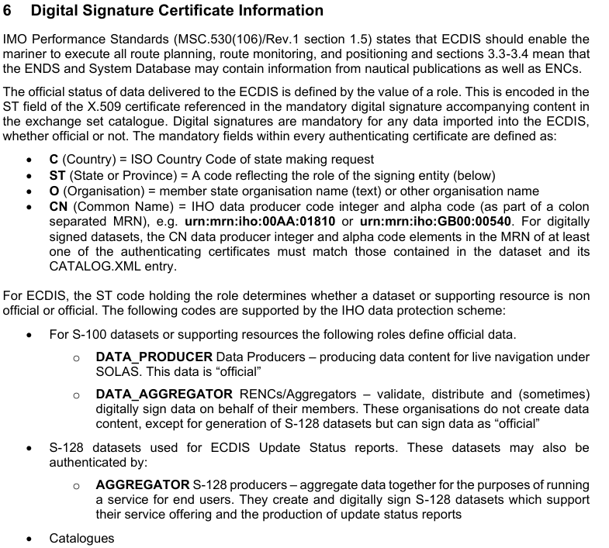
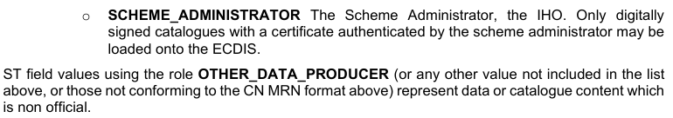
Data constraints Annex clause 6

Slide 28
Changes arising from S-98 D.C.A. (MAR 2026) - 4
Location | Summary | Disposition
7 | Exchange sets delivered to ECDIS must only contain: S-100 datasets, any required dataset support files, S-100 catalogues (feature and portrayal catalogues) language packs, referred to as “system support files” Notes: (1) Excludes ISO metadata files. (2) Supporting resources such as language and enumeration dictionaries must be included under “system support files”. (3) Language prohibits mixed S-57/S-1xx datasets. | New S-98 check or checks. 100_0279, 100_0280 partially relevant
7.1 | Management of automatic updates to Dataset Support files | No validation-related requirement stated
7.2 | File-less cancellation: “Additionally a cancellation signature, a signature of the original Data producer signature must be present and valid.” | New VC requiring cancellation signature in addition to original data producer signature.
8.1 | S-102 & S-104 data must be regular grid S-111 data must be regular or irregular grid | 2 new S-98 validation checks
9 | Compatibility of feature and portrayal catalogues | No effect on validation
9 | Form of product specification edition number | New S-98 check

Slide 29
Changes arising from S-98 D.C.A. (MAR 2026) - 5
Location | Summary | Disposition
9.1 | Portrayal and feature catalogue compatibility | No dataset/exchange set validation-related requirement.
9.2 | Construction of feature and portrayal catalogues | No dataset/exchange set validation requirement. Requirements pertaining to context parameters in PC are a PS requirement and must be checked by PS developers.
10 | Dual-fuel mode | No validation-related requirement.
11 | Data overlaps | No validation-related requirement.
12 | S-101 Scale boundaries must be included in datasets | HDF5 datasets don’t have DataCoverage features. For vector data products, including scale boundaries in datasets (presumably via DataCoverage) is a PS requirement.
12 | These (scale values) must also match those values contained in the CATALOG.XML. | May be redundant with S-158:1xx checks.

Slide 30
Changes arising from S-98 D.C.A. (MAR 2026) - 6
Location | Summary | Disposition
12 | All datasets within exchange sets must define minimumDisplayScale, optimumDisplayScale and maximumDisplayScale | Contradicts S-101, where minimumDisplayScale is allowed to take the value NULL. Note also that HDF5 datasets don’t have DataCoverage and cannot define min/max/optimum scales in the dataset. Will interpret requirement as pertaining to discovery metadata and allow omission of minimumDisplayScale (schema does not allow NULL since it is an optional attribute). New VC comparing scales in discovery metadata to scales in DataCoverage (if present). New VC requiring maximum & optimum display scales in discovery metadata at all times. New VC requiring minimum display scale in metadata if and only if encoded in a DataCoverage.

Slide 31
Changes arising from S-98 D.C.A. (MAR 2026) - 7
Location | Summary | Disposition
12 | NotForNavigation may be included in CATALOG.XML but is ignored by S100 ECDIS. If it is required to indicate data for testing purposes then a specific Producer code should be used. Dataset Titles may also be used to indicate this for product specifications supporting titles. | Don’t see how a validation check can be written for this paragraph. Why should ECDIS ignore NotForNavigation=true? Without this permissive statement a check would be possible.
12 | Catalogues may only be signed by the Scheme Administrator using the scheme administrator MRN | New validation check?
13 | Scales in S-100 data – ENC scale – must use one of fixed set of values | New S-98 validation check? Note that NULL cannot be encoded in discovery metadata scale attributes.
14 | For S-102 and S-104 datasets, ECDIS supports gridded data in DCF 2 format only. | Duplicates 8.1
14 | For S-111 datasets, ECDIS supports gridded data in DCF 2 or DCF 3 format only | Duplicates 8.1

Slide 32
Changes arising from S-98 D.C.A. (MAR 2026) - 8
Location | Summary | Disposition
14 | S-101, S-104 and S-102 Horizontal Datums must be the same in areas of overlapping coverage. | Covered by 98_1001
14 | S-101, S-102 and S-104 Vertical Datums must be the same in areas of overlapping coverage. | Covered by 98_7001 and 98_7002, which compare S-102 & S-104 to S-101. Add new check which works in absence of S-101 data?
14 | All depth measurements must be positive down. | New check for axis direction of vertical axis, if specified in dataset. (Should be in S-158:1xx checks instead of S-98 checks.) Values cannot be reliably checked, though heuristic checks are possible for excessive –ve depth values.

Slide 33
Changes arising from S-58 edition 9 and S-158:101
Location | Summary | Disposition
 | In progress

Slide 34
Validation check standardization
Remove Collection B checks from spreadsheet.
Classification as “Critical”:
Is the entire dataset unusable if any one of the features is mis-formatted or otherwise unreadable?
Is the entire dataset unusable if any one of the information types is mis-formatted or otherwise unreadable?
Are all features and information types equally essential, in every data product?
Provisionally – no provision for assigning level of importance to feature types or information types. Errors classified “C” in generic checks are “C” errors no matter which feature or info type contains the error. [Final report will recommend action in a future edition of S-158 / S-158:100.]
Some generic checks mention the PS, but there is no way to cite PS clauses in the generic checks. Generic checks should not reference the PS unless it is impossible for the PS to add restrictions (as for the FC). [Agreement by validation sub-group TBD]
Implementers don’t necessarily realize what is a requirement and what isn’t.
“For example ...” is just an example, not a specification.
Implementers overlook requirements in S-100 and product specifications even when stated as “... must ....”
S-100 and product specifications should use a method to unambiguously indicate what is a requirement or recommendation. Cf. recent ISO TC211 standards’ approach to identifying requirements (boxed text + /x/y/z identifier).
Final report will recommend action in future editions of S-100 and S-1xx.

Slide 35
Combining S-100 and PS in Generic checks
Typical examples where “delegation” works and does not work:
Values of HDF5 data fields in attributes and datasets must conform to the constraints defined by the Product Specification. (100_0189)
For each IACS-IACD subfield value that is not defined by the product specification's feature catalogue. (100_0103)
The name of each data group is must be of the form 'Group_nnn’. (100_0195)
Comments received:
As a statement of conformance, delegation works. Checks that test S-100 Part 10c container mechanics — presence of Group_F, the featureCode array, feature information compound types, Group_NNN naming — are genuinely S-100 level, and restating them per product mainly creates copies that drift from the original.
As a specification for a validator, delegation fails for value constraints. The load-bearing generic checks are 100_0189 (“Values of HDF5 data fields in attributes and datasets must conform to the constraints defined by the Product Specification”) and 100_0214 (“… where the value does not conform to the constraints specified in Table 10c-10 or the Product Specification …”). Both are true statements and neither is executable, because a validator implementing them needs the product constraints in machine-readable form.
Proposed solutions (perhaps depending on the S-100 Part?):
Remove checks mentioning PS value constraints or attributes defined in the PS from S-158:100 and make them product-specific checks.
Remove references to PS from S-158:100. S-100 generic checks should reference only S-100. Product-specific checks should reference only the PS. Product-specific checks should be written so as not to duplicate S-100 requirements. The Project Teams should be responsible for avoiding unnecessary redundancy in S-158:1xx

Slide 36
Implementation guidance
Whether a check is expected to be implemented by “traditional” validation or other means.
Visual inspection of feature
Heuristic, for coordinates – compare coordinates to bounding box, (other heuristics?)
“Historical” – compatibility with history of dataset (e.g., edition & update numbers)
Outline of expected implementation
Partial implementation – some combinations of possibilities may lead to a definite pass or fail, some may lead to an “undetermined” result
Other types of check-specific guidance?
Validation software should add “undetermined” as a check result.
“undetermined” is not equivalent to “not implemented”

Slide 37
Upgrade of cover documents
Update references
S-100 5.2.1, S-98 3.0.0
Add “Implementation guidance” column to check structure
Collection B checks removed from S-158:100

Slide 38
Requirements for Infrastructure / artefacts
List-form display as in Excel lists of checks for Edition 2.
Provide for additional product-specific fields in checks.
Provide for associating an optional free-text or structured annotation (for example a table) to each check.
Designate checks as common to multiple data products.
Select checks by data product or generic S-100 checks and the edition to which a check is applicable, in addition to the introduced/modified/deleted fields
Text search of Message, Description, and Solution fields.
Export results in spreadsheet (or at least CSV?) and XML
Export as Word, HTML or PDF document (only if need is identified)?
Select fields to be exported
Add Key Terms field to facilitate search – allow S-158:... authors to tag checks with terms which provide more details than the standard fields, such as “root group”, “regular grid”, etc.
Provide for a standardized but easily expandable list of key terms.
Other requirements?

Slide 39
Engagement and review
Validation subgroup meeting
September 1
...
Materials for S-100 WG meeting September 2026
Draft Edition 2.0.0 of S-158:100
Draft Edition 2.0.0 of S-158:98

